Slide 1
César Chávez, Dolores Huerta y la unión de campesinos.
Por:
Pedro, Forrest y Laura

Slide 2
Biografía

Slide 3
Juventud

Slide 4
Servicio Militar

Slide 5
Community Service Organization(CSO)

Slide 6
Dolores Huerta

Slide 7
Unión de campesinos(UFW)

Slide 8
VIDEO
http://video.pbs.org/video/2365077267/

Slide 9
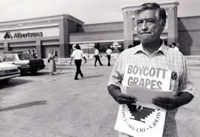
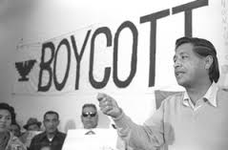
Estrategias-Boicot

Slide 10
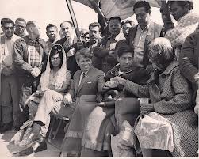
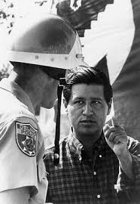
Huelga de hambre

Slide 11
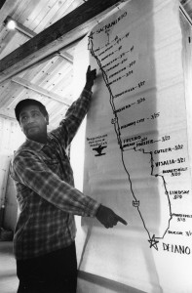
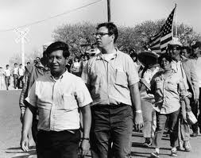
Marcha a Sacramento 1966

Slide 12
Logros
Derecho a formar sindicato.
Pago más alto.
Cambios tecnológicos de herramientas.

Slide 13
MOVIMIENTOS SOCIALES
Vietnam
Derechos para los homosexuales

Slide 14
Defensa de animales
“I became a vegetarian after realizing that animals feel afraid, cold, hungry and unhappy like we do. I feel very deeply about vegetarianism and the animal kingdom. It was my dog Boycott who led me to question the right of humans to eat other sentient beings.”

Slide 15
We need, in a special way, to work twice as hard to make all people understand that
animals are fellow creatures, that we must protect them and love them as we love
ourselves. And that’s the basis for peace. The basis for peace is respecting all creatures. . . . We cannot hope to have peace until we respect everyone–respect ourselves and respect animals and all living things. . . . We know we cannot defend and be kind to animals until we stop exploiting them – exploiting them in the name of science, exploiting animals in the name of sport, exploiting animals in the name of fashion, and yes, exploiting animals in the name of food.

Slide 16
Fin

